Slide 1


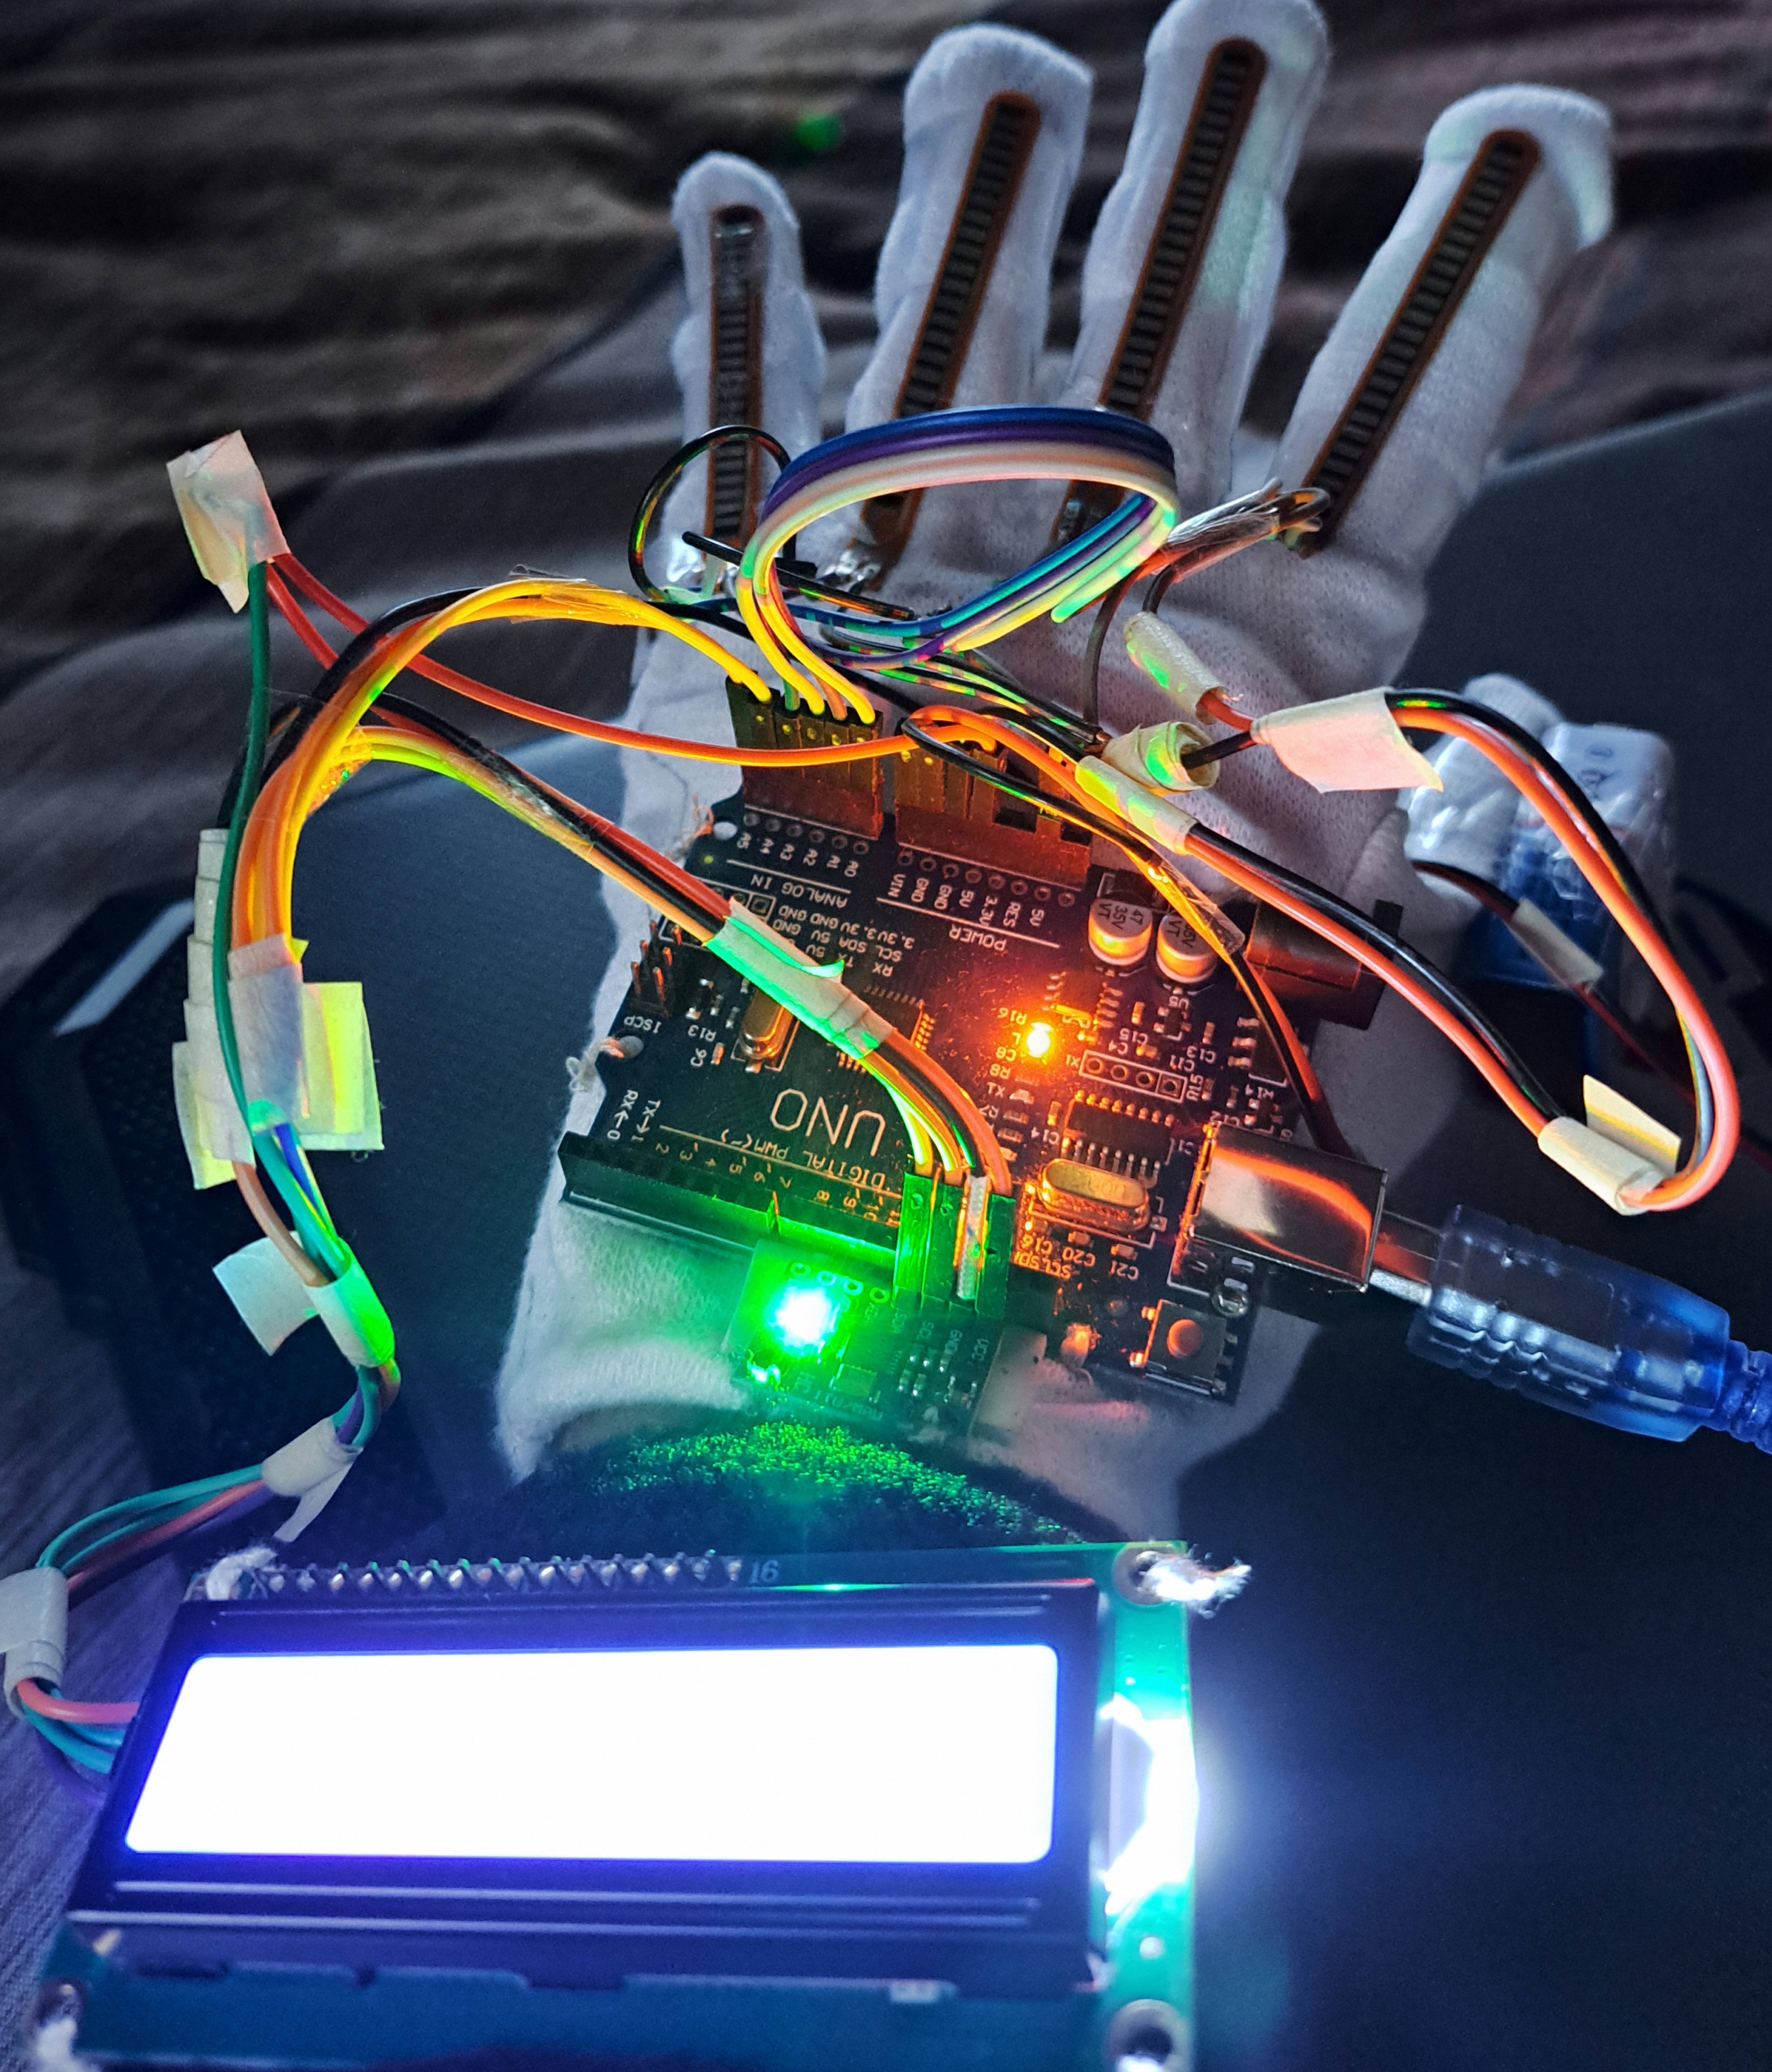
Mini Project Title,
Gesture Vocalizer or Sign Language to voice converter
EC-681
BACHELOR OF TECHNOLOGY
IN
DEPARTMENT OF ELECTRONICS AND COMMUNICATION ENGINEERING
Team Members -
Name
Univ. Roll Number
Raj Baidya
10800322086
Shribas Kundu
10800322087
Beetan Mukherjee
10800322065
Avinaba Acharjee
10800322085

Slide 2
The Communication Divide
Over 70 million deaf individuals globally rely on sign language. Significant communication barriers exist with hearing individuals. Current solutions are often expensive, slow, or limited in vocabulary. This impacts education, healthcare, and daily social interactions.
Global Impact
Current Gaps
Social Barriers
70+ million deaf individuals use sign language, facing daily barriers.
Existing technologies are costly, slow, and lack comprehensive vocabulary.
Challenges in education, healthcare, and everyday interactions persist.

Slide 3
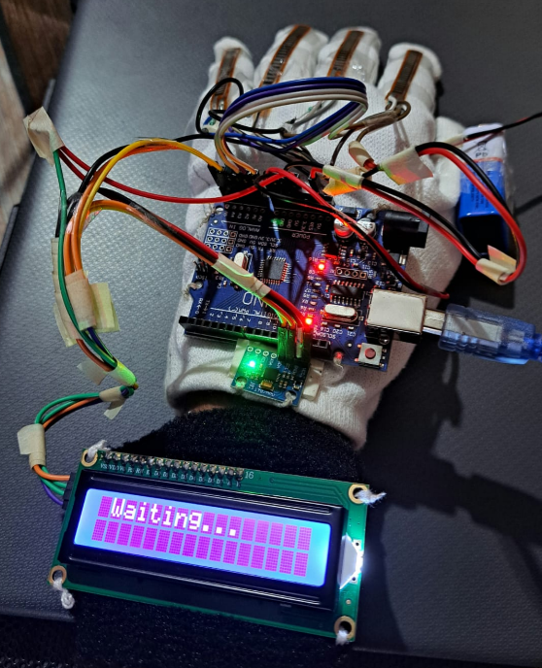
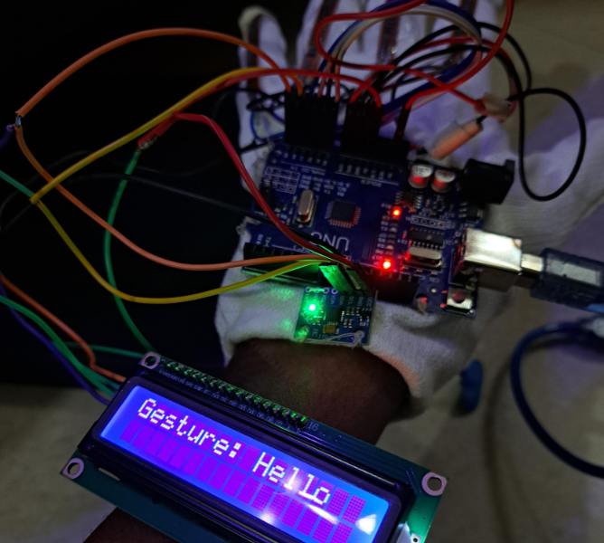
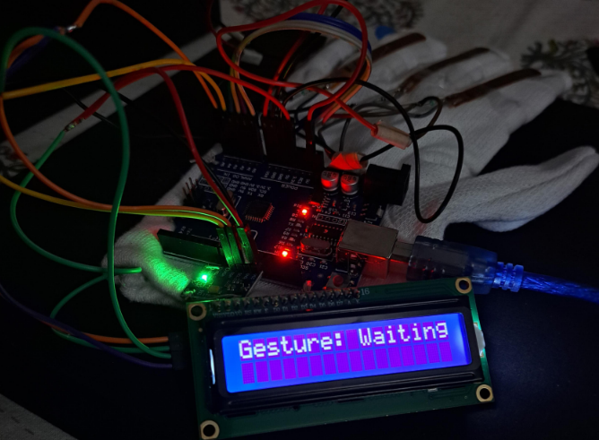
Our Solution: The Gesture Vocalizer
Our innovative device converts sign language gestures into spoken words. It is portable, user-friendly, and cost-effective. The Gesture Vocalizer fosters seamless, instantaneous communication. It empowers deaf individuals in diverse environments, promoting inclusion.
Innovative
Accessible
Empowering
Converts gestures to voice instantly.
Portable, user-friendly, and affordable.
Fosters seamless communication.

Slide 4
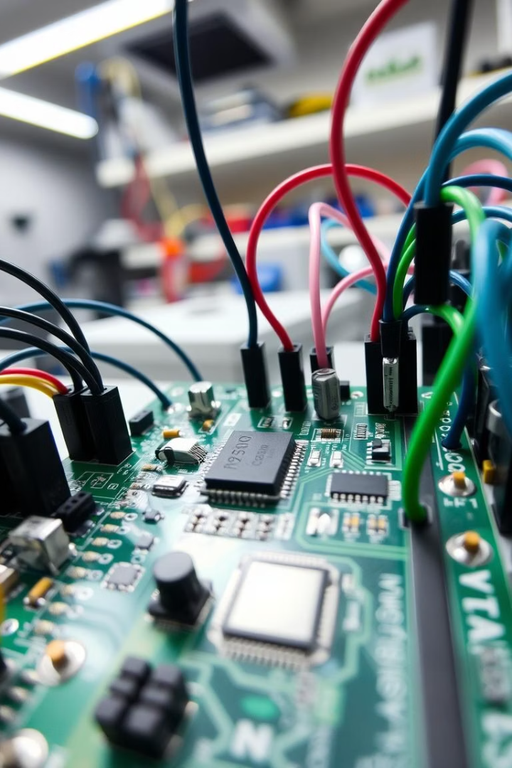


Technology Under the Hood
The Gesture Vocalizer combines specialized hardware and intelligent software. This synergy enables precise gesture capture and rapid voice output. Our design prioritizes both performance and portability.
Hardware Components
Software Requirements
Flex Sensors (4)
Used TINKERCAD for circuit creation and run
MPU6050
Arduino UNO
Arduino IDE to write C++ program and upload it into Arduino UNO Board
Display
10kOhm Resistors
Hand Glove & Jumping Wires

Slide 5




How It Works: The Conversion Pipeline
The gesture vocalizer translates hand movements into speech by detecting finger and wrist gestures using flex sensors and MPU6050, processing them through Arduino UNO. The interpreted gestures are then displayed on an LCD.
1. Gesture Capture
Hand gestures are captured by flex sensors. As flex sensors are resistive device, hence it produces resistive values (exp. 715 Ohm) which will be pass through jumping wires and connected with the A0, A1, A2 and A3 points of Arduino UNO Board.
2. MPU6050 Accelerometer
Accelerometer is used to capture hand motions and varies in all x,y and z direction.
3. Arduino UNO
Inputs are provided in Arduino Uno board via flex sensors
4. Text Generation using Display
Recognized sign mapped to corresponding English word or phrase.

Slide 6
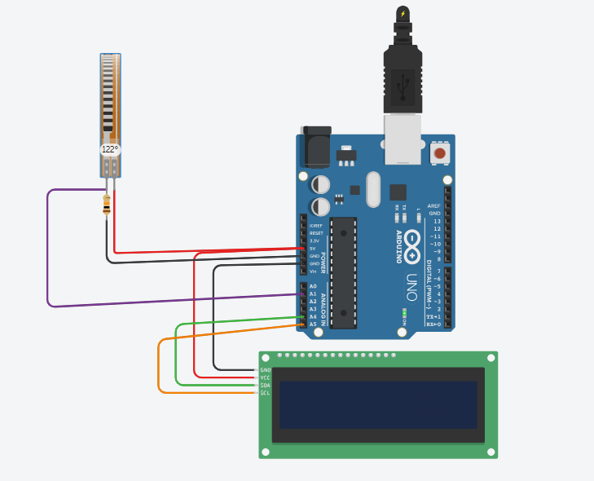

Key Features & Advantages
Features -
Real-time gesture recognition using flex sensors and MPU6050.
LCD display to show recognized words.
Low power consumption with microcontrollers like Arduino.
Customizable gesture-to-speech mappings.
Advantages -
Cost-effective alternative to commercial speech devices.
Lightweight and wearable, promoting ease of movement.
Circuit Creation and run using TINKERCAD software

Slide 7
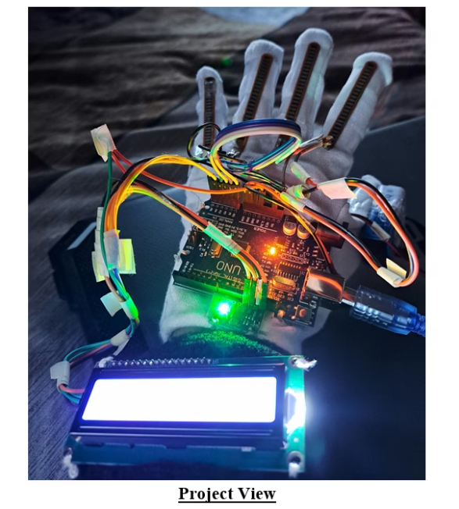
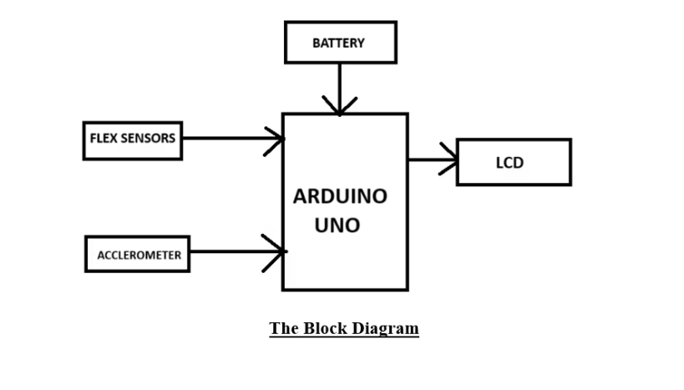
Block Diagram & Project View

Slide 8

Impact & Real-World Applications
The Gesture Vocalizer revolutionizes communication across various sectors. It significantly improves accessibility and promotes social inclusion. Our solution has the potential to transform thousands of daily interactions.
Education
Facilitates classroom participation for deaf students, fostering inclusivity.
Healthcare
Improves doctor-patient communication in urgent care scenarios.
Customer Service
Enhances accessibility in retail and public service environments.
Social Inclusion
Promotes easier daily interactions and reduces social isolation for deaf individuals.

Slide 9
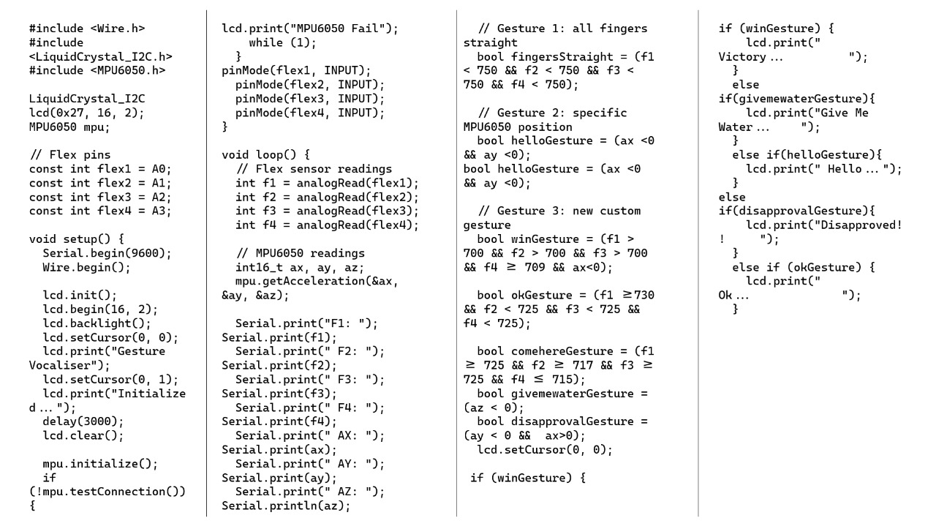
Software Implementation
The Arduino is programmed using the Arduino IDE. The following is a simplified version of the code:

Slide 10





Future Vision & Enhancements
Our future vision for the Gesture Vocalizer includes significant enhancements. We aim to expand its capabilities and improve its design. These advancements will make the device even more versatile and user-friendly.
Contextual AI
1
Understanding nuances and emotional tone.
Miniaturization
2
Sleeker design, integrated smart fabric.
Multi-language
3
Support for BSL, LSF, and other sign languages.
Bi-directional
4
Voice-to-text display for deaf users.
Expanded Vocabulary
5
Integration of full ASL lexicon (3,000+ signs).

Slide 11

Conclusion:
The Gesture Vocalizer is a promising step towards inclusive communication. Our team is committed to continuous innovation and development. Your questions and feedback are invaluable as we move forward. Thank you for your time and interest in our project!
THANK
YOU!
Promising Step
Towards inclusive communication.
Continuous Innovation
Team commitment to ongoing development.
Q&A
Your feedback is invaluable.

